Slide 1




Slide 2
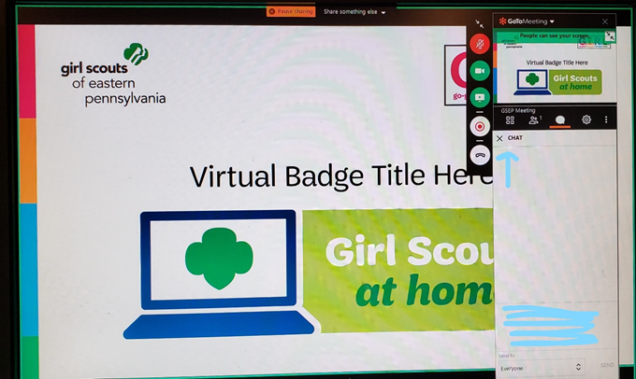
How will this Virtual Troop Meeting work?
On the right side of your screen, there is a control panel. You should see a microphone, a video camera and a chat bubble.
•When we sing together, you will want to click on your microphone so it is green. Then everyone will be able to hear you.
•If you have a webcam, clicking on it will let everyone else in the meeting see you too.
• The Chat Log looks like a cartoon thought bubble…see it underlined in red? You can type questions or comments into the chat log and everyone will be able to see what you write!

Slide 3
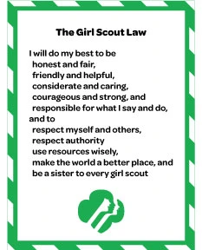
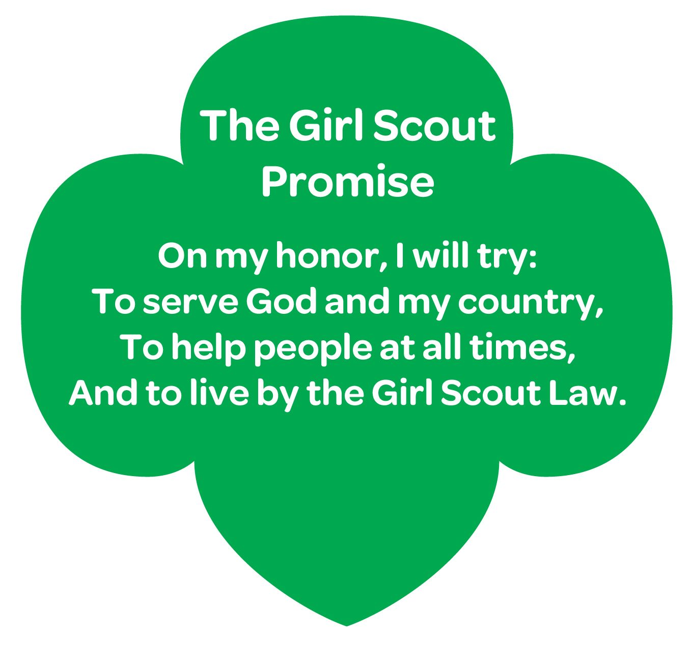
Girl Scout Promise
and Law

Slide 4
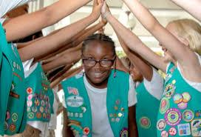
HERstory - Tying it Together
We will explore famous women in history.
We’ll learn about ordinary women who did extraordinary things.
We’ll also learn about women alive today who are making a difference.
Women from the pages of HERstory
Purpose of this activity: To learn about women in history who are perhaps lesser known but every bit as important and influential as more well-known women in history. To learn about ordinary women doing extraordinary things.
Notes:
Ask the girls which of the women made the most impact (allow the girls to express their opinion – remember, all answers are allowed).
Ask the girls if they have a woman in their own family (past or present) they consider extra- ordinary. Let them express why/how.

Slide 5
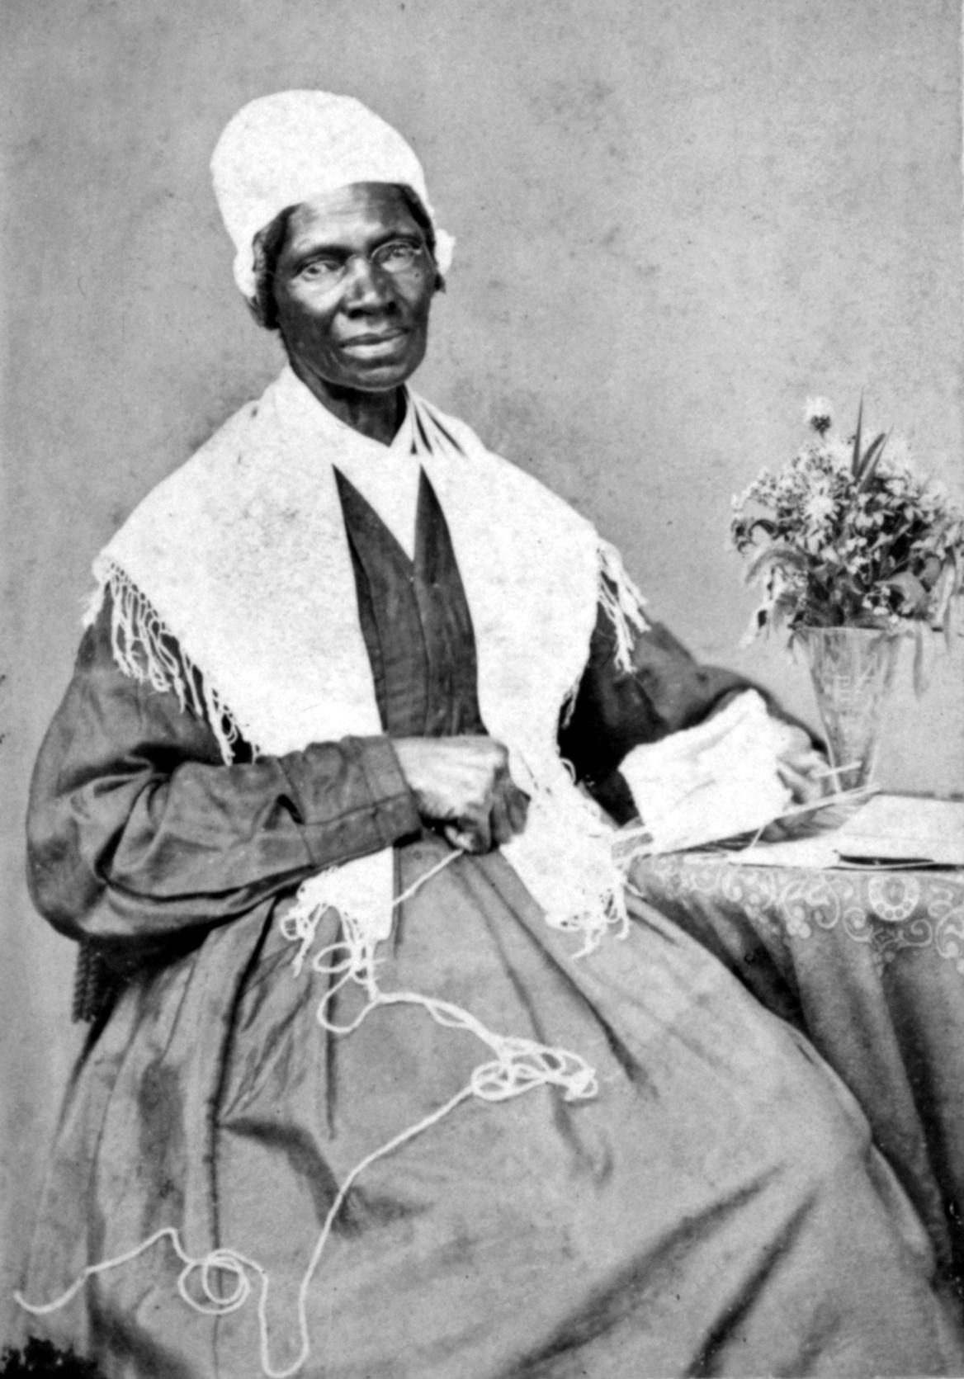
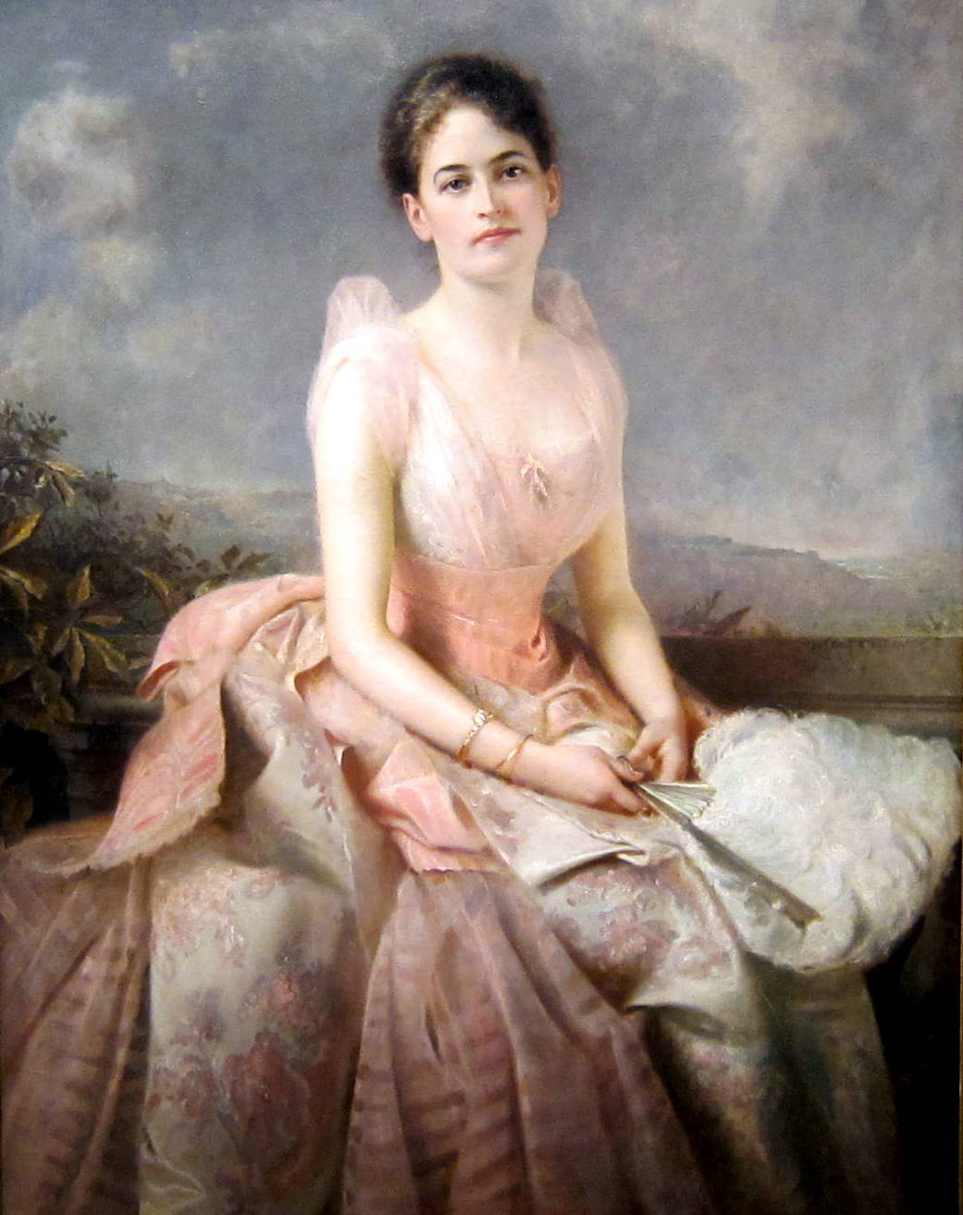
Women in HISTORY
Abolitionist and women's rights activist Sojourner Truth is best known for her
speech on racial inequalities, "Ain't I a Woman?" delivered at the Ohio
Women's Rights Convention in 1851.
Juliette Gordon Low spent her early life in the South as a member of a socially
and financially elite family. After the death of her millionaire husband, Low
met William Baden-Powell, founder of the Boy Scouts, which inspired her to
create the Girl Scouts of the United States of America. Following a battle
with breast cancer, she died in Savannah, Georgia in 1927.

Slide 6
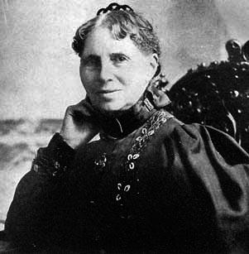
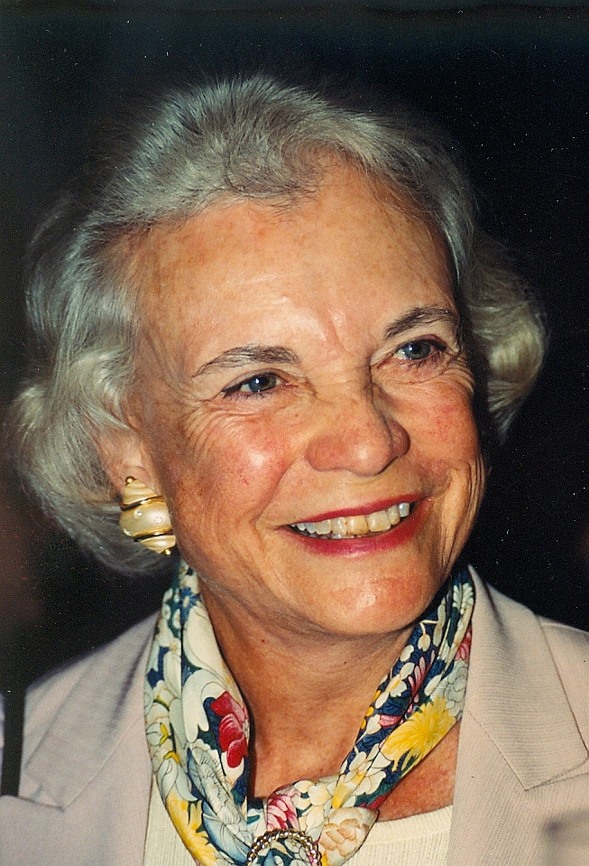
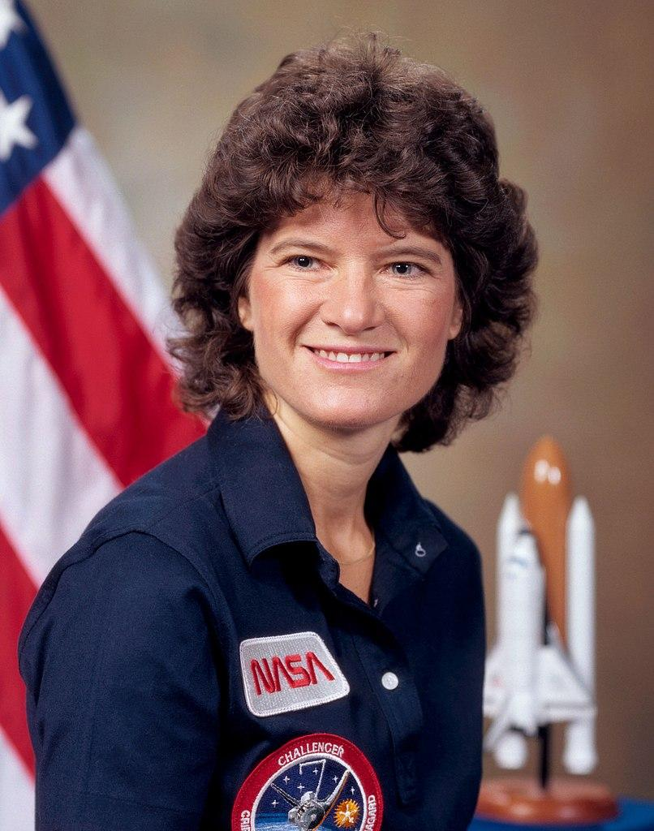
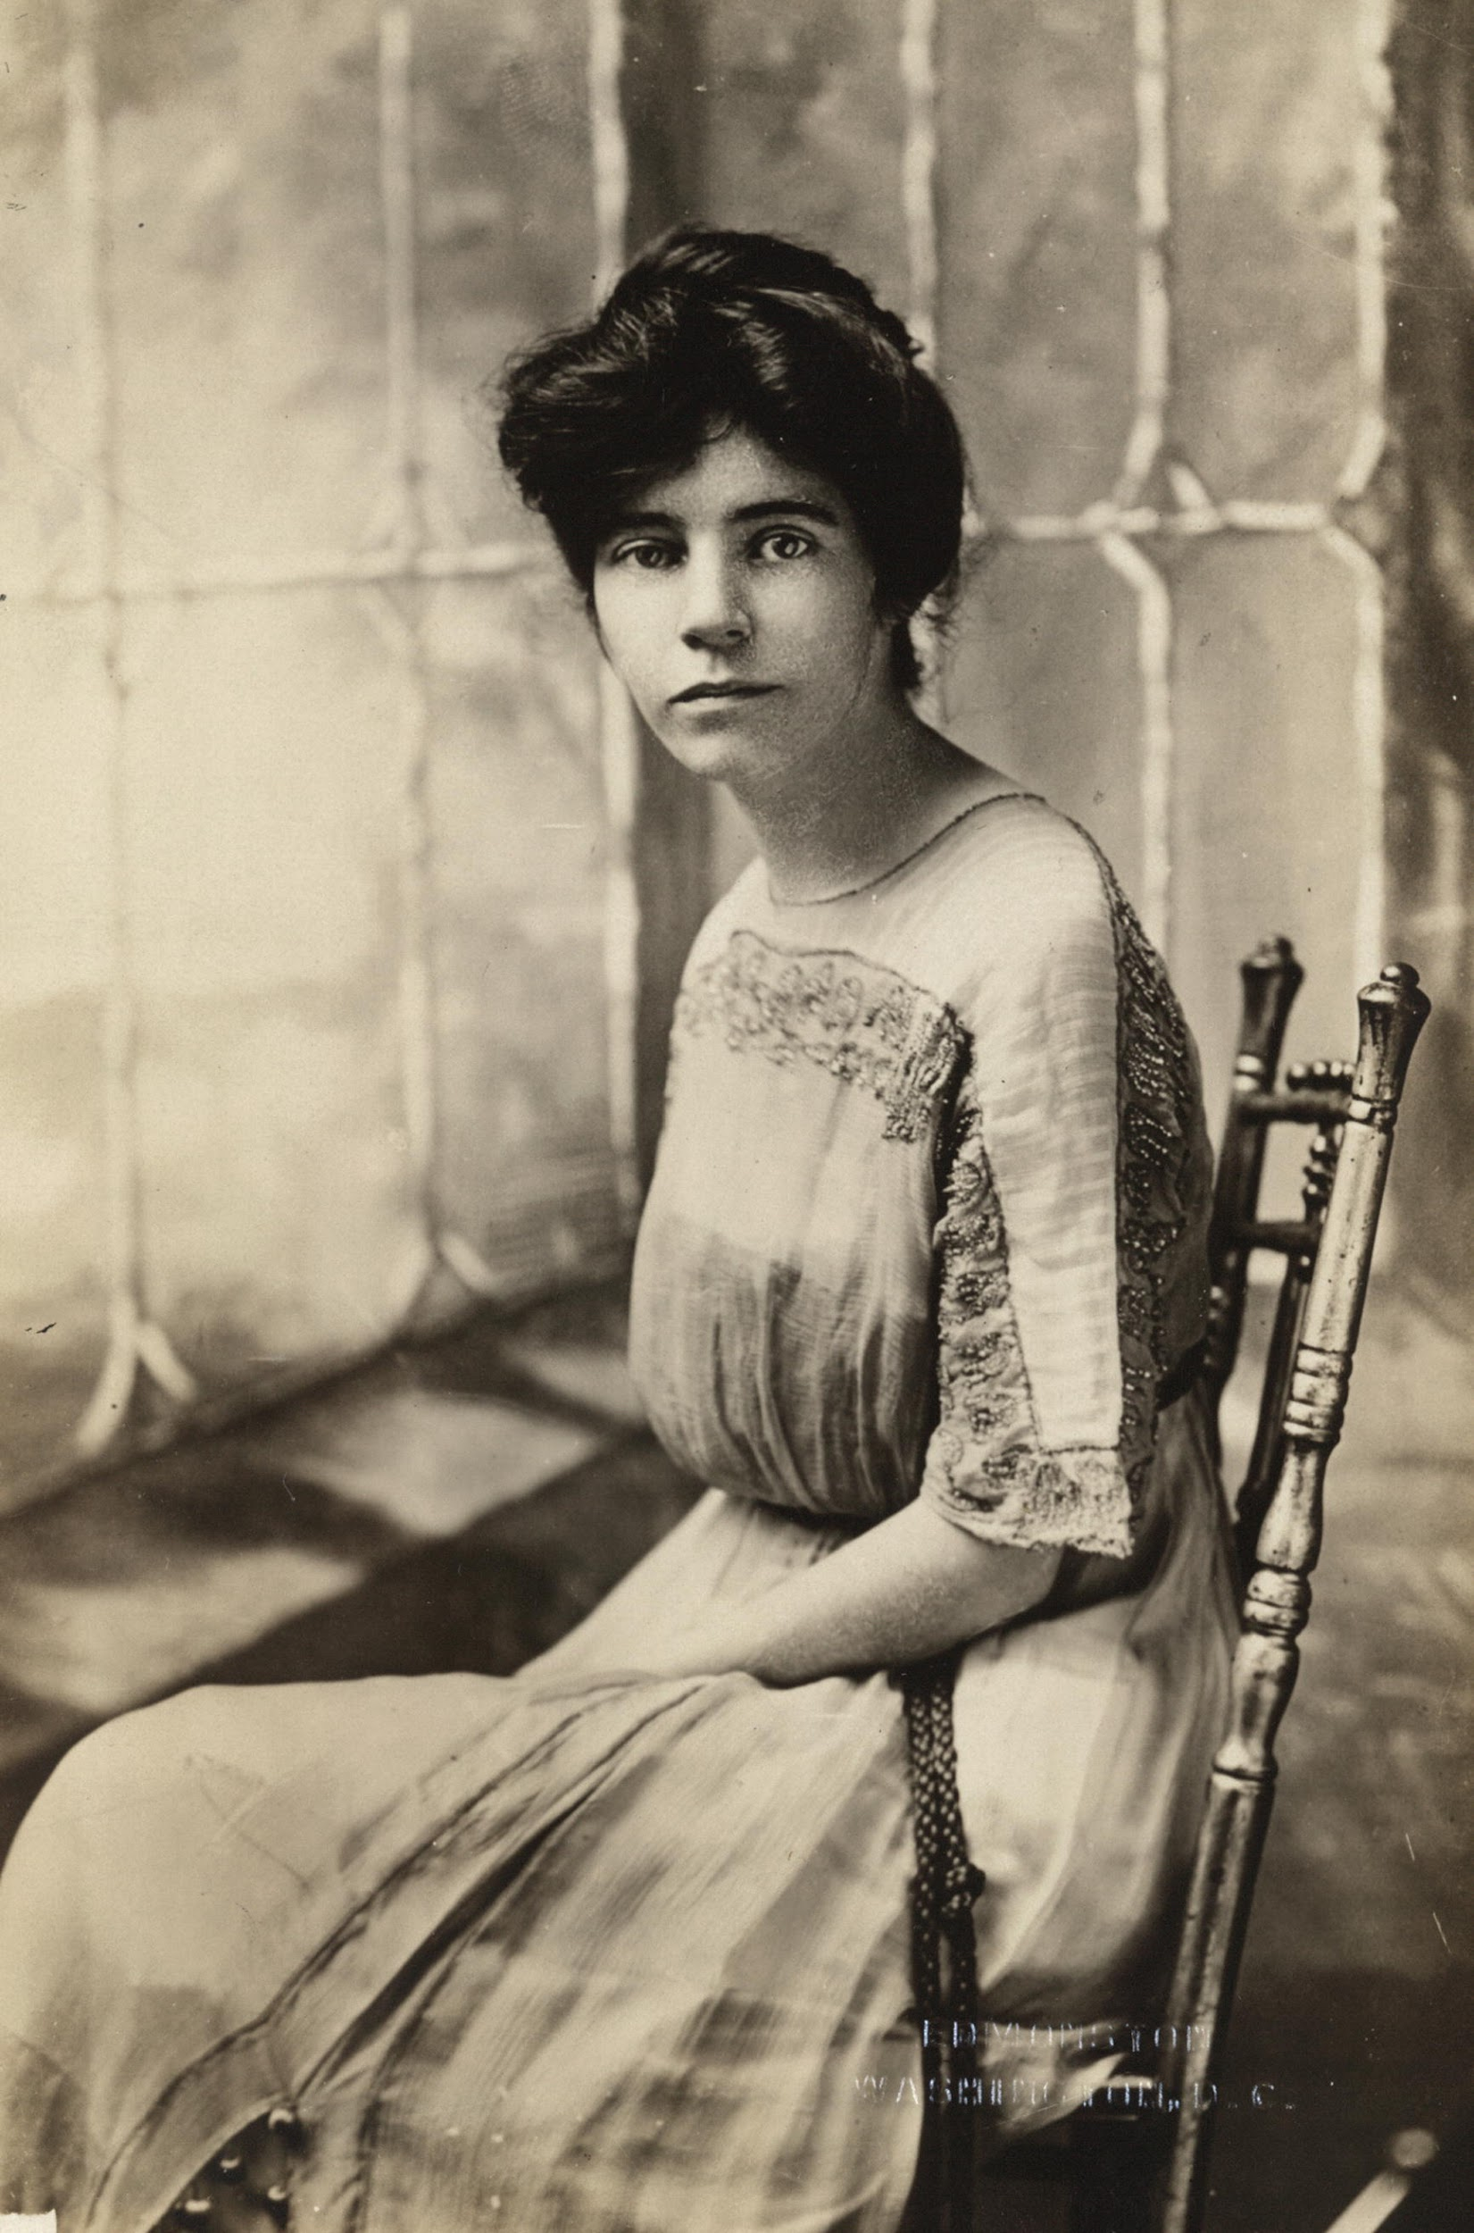
Women in HISTORY
Clara Barton was an educator, nurse and founder of the
American Red Cross.
Sandra Day O'Connor was the first woman appointed to the U.S. Supreme Court.
A Republican, she was considered a moderate conservative and served for 24 years
In 1983, astronaut and astrophysicist Sally Ride became
the first American woman in space aboard the space
shuttle Challenger.
Suffragist Alice Paul dedicated her life's work to women's rights and
was a key figure in the push for the 19th Amendment.

Slide 7
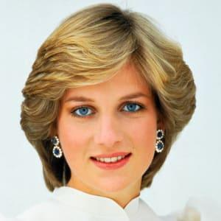
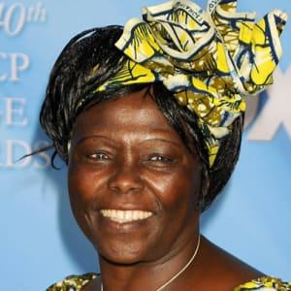
Women Who did Extra-ordinary Things
Princess Diana was Princess of Wales while married to Prince Charles.
One of the most adored members of the British royal family,
she died in a 1997 car crash.She is remembered as the
"People's Princess" because of her widespread popularity and
global humanitarian efforts.
Wangari Maathai was a Kenyan political and environmental
activist and her country's assistant minister of environment,
natural resources and wildlife.

Slide 8
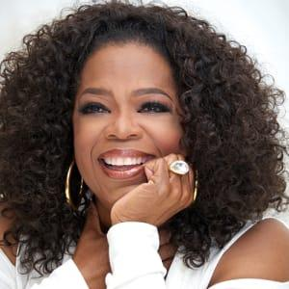
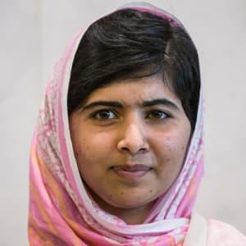
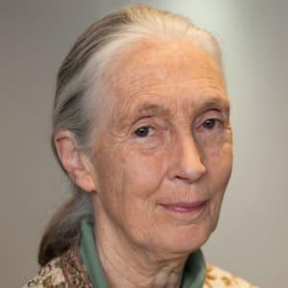
Women Alive Today Who Are Making a Difference
Billionaire media executive and philanthropist Oprah Winfrey is best known
for hosting her own internationally popular talk show from 1986 to 2011.
From there she launched her own television network, OWN.
As a young girl, Malala Yousafzai defied the Taliban in Pakistan
and demanded that girls be allowed to receive an education.
She was shot in the head by a Taliban gunman in 2012 but survived.
In 2014, she became the youngest person to receive the Nobel Peace Prize.
Jane Goodall is known for her years of living among chimpanzees in
Tanzania to create one of the most trailblazing studies of primates
in modern times.

Slide 9
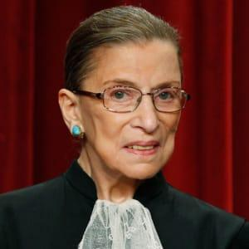
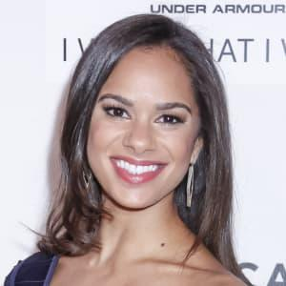
Women Alive Today Who Are Making a Difference
Ruth Bader Ginsburg is a U.S. Supreme Court justice, the second
woman to be appointed to the position.
Acclaimed ballerina Misty Copeland is the first African American performer to be appointed as a principal dancer for American Ballet Theatre

Slide 10
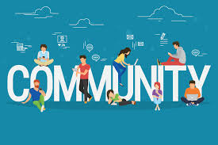
The Power of Community - Tying It Together
You will now begin the final leg of the journey. You will begin to look at your community and decide on something that you can do to help out.
Notes:
Have the girls discuss and brainstorm what are some steps to figure out what they can do in their community to help

Slide 11

Ready, Set, ACTION!!
Next Steps:
Come up with your top 3 choices for your Take Action Project.
Once decided, begin to work on your action plan and ways to connect in the community.
Don’t forget to connect with your Troop Leader and Parents for support and guidance

Slide 12
